Slide 1

Data Description
Session 6
M. Kachour

Slide 2
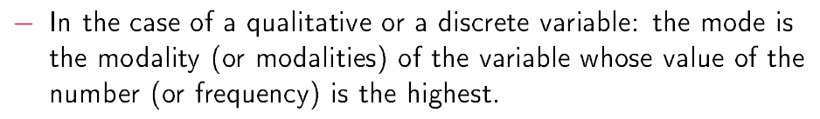
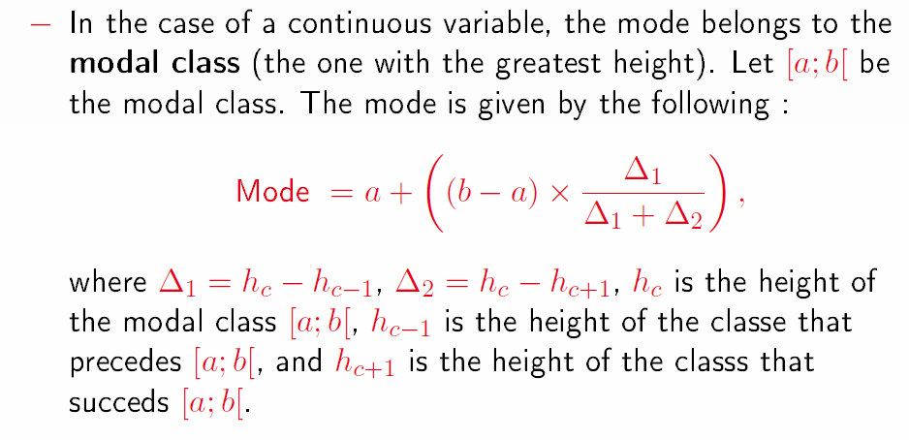
Position Indicators – Mode
The best represented observation of the observed data is called the mode.
The mode is considered as a central value associated with the data.
Note that the mode is not necessarily a single value.

Slide 3
Note

Slide 4
Examples – calculation of the mode
Example 1: The data below represents the wage distribution of 15 employees working in a small business
Identify the mode(s)associated with data.
Salary | Number of employees
1300 | 3
1850 | 5
2050 | 5
3000 | 2

Slide 5
Note

Slide 6
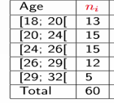
Examples – calculation of the mode
Example 2: The data below represents the ages of 60 candidates in a competition
Identify the mode(s)associated with data.

Slide 7
Note

Slide 8
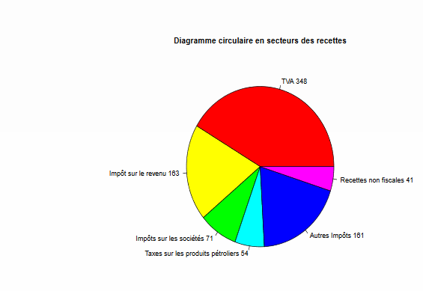
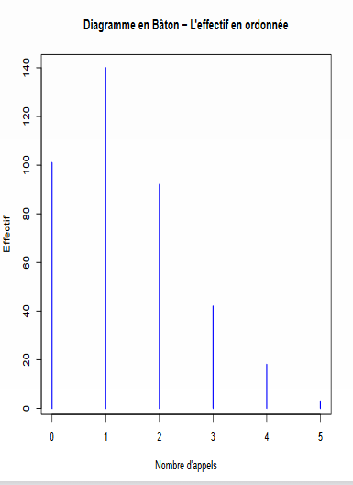
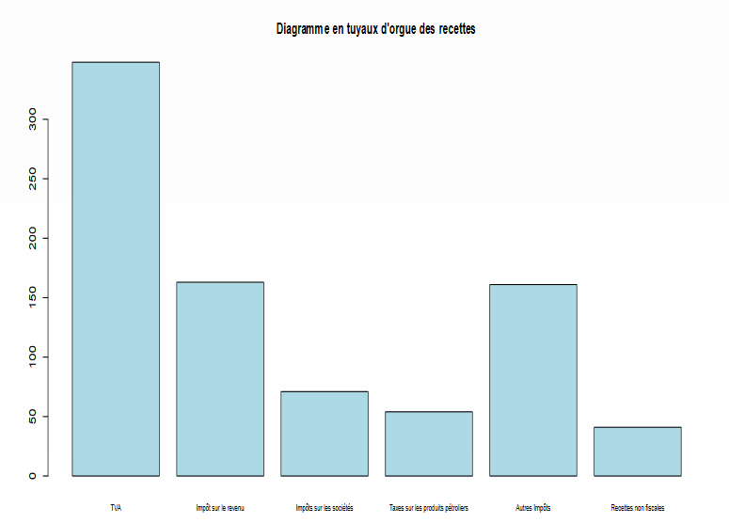
The mode - Graphically

Slide 9
Note

Slide 10
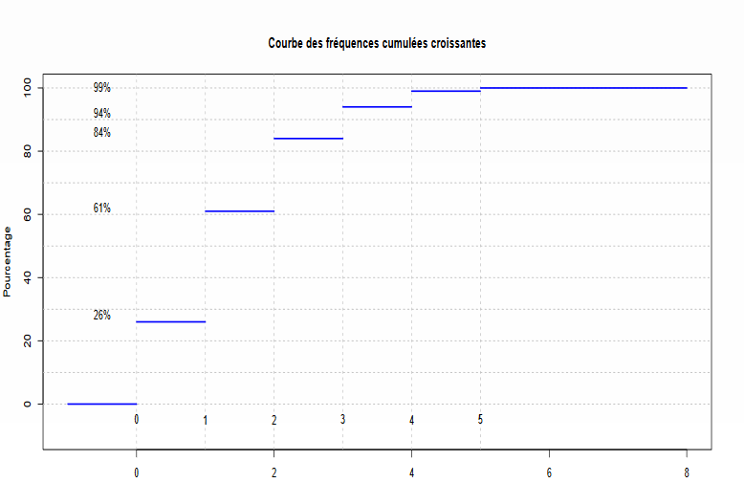
The mode - Graphically
The highest step

Slide 11
Note

Slide 12
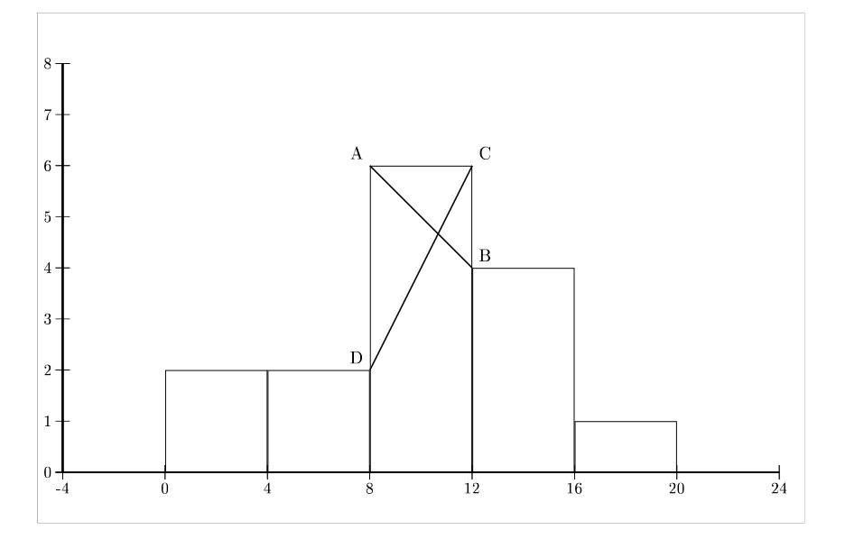
The mode - Graphically

Slide 13
Note

Slide 14
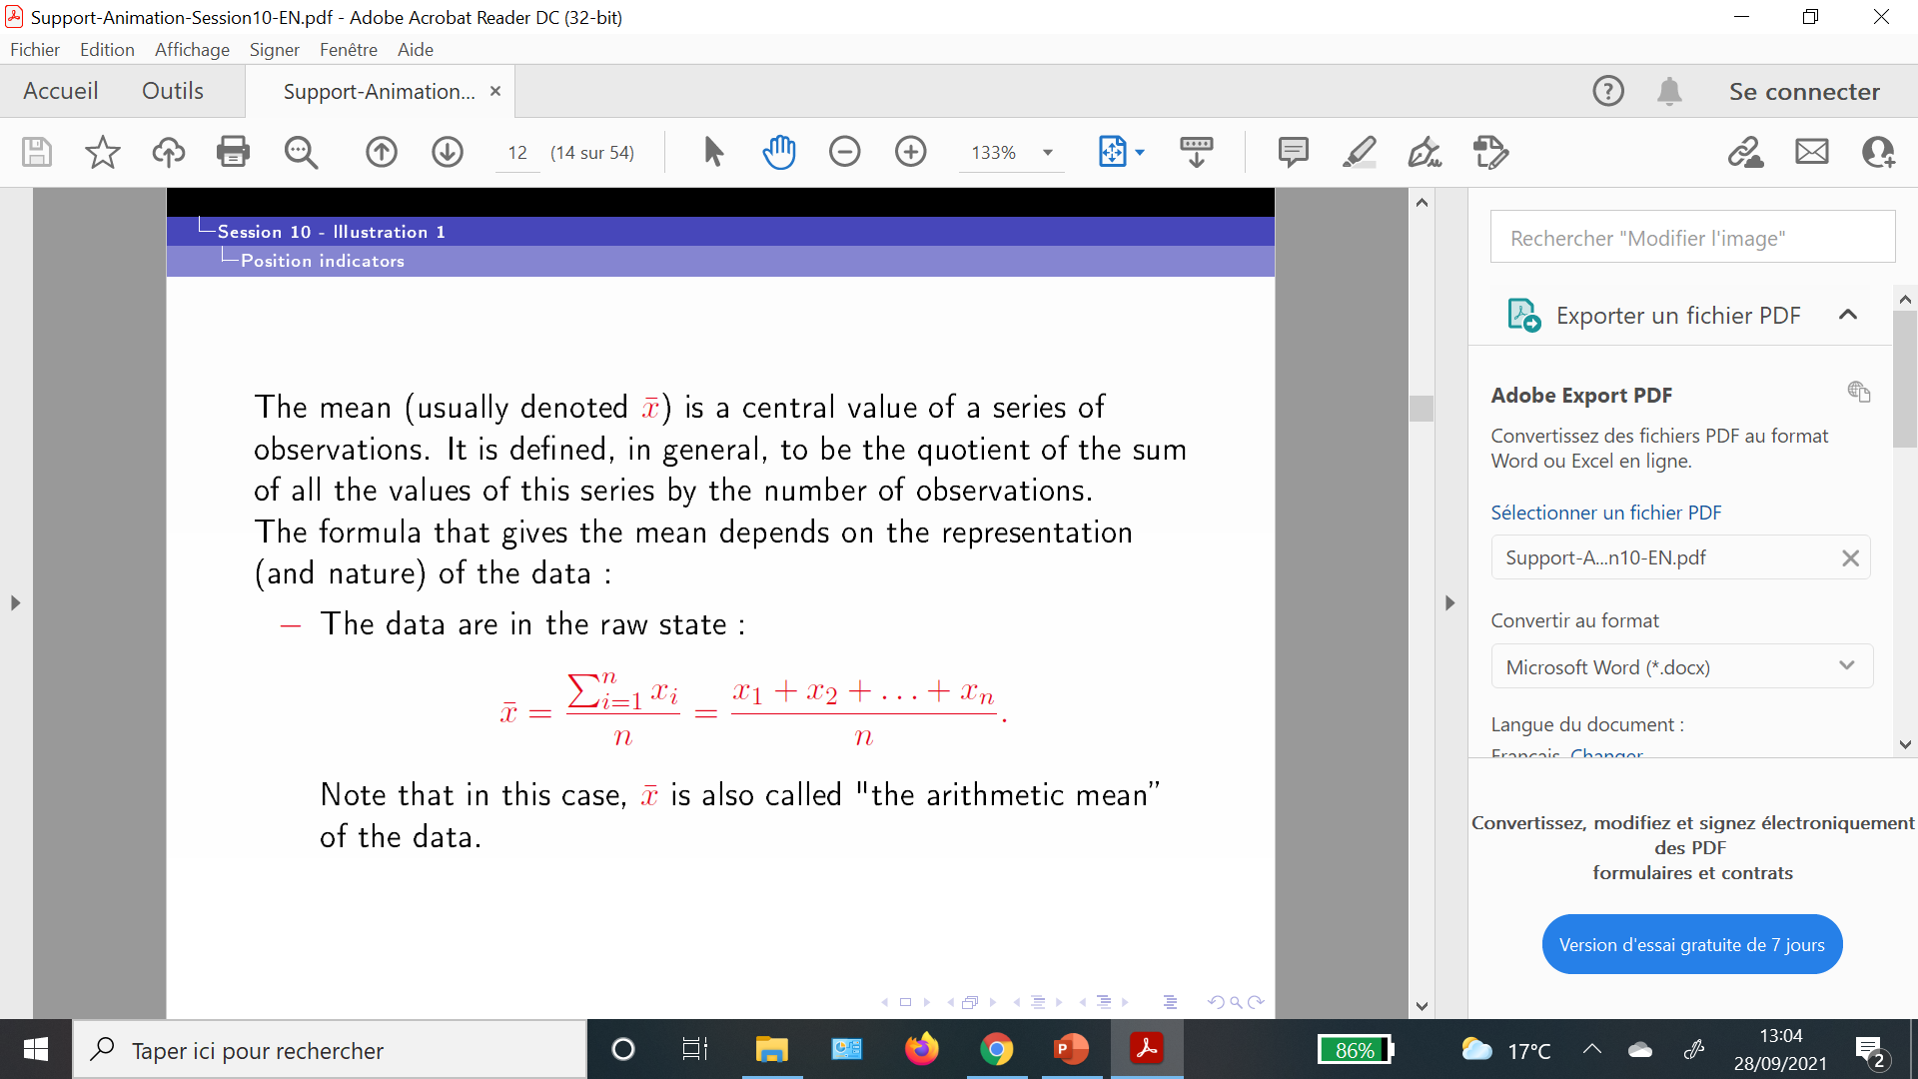
Position indicators – The mean
Indicator associated with data from a quantitative variable only

Slide 15
Note

Slide 16
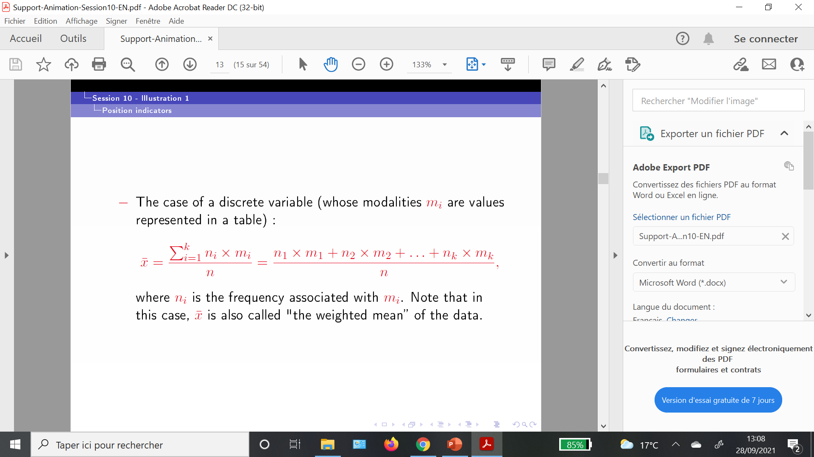
Position indicators – The mean

Slide 17
Note

Slide 18

Position indicators – The mean

Slide 19
Note

Slide 20
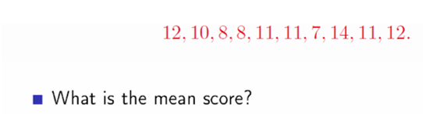
Examples - calculation of the mean
Example 1 :
The data below represents the grades / scores of 10 students

Slide 21
Note

Slide 22
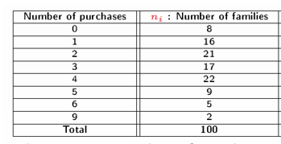
Examples - calculation of the mean
Example 2 :
The data below represent the number of purchases (per week) of a product studied out of 100 French families.
Calculate the mean.

Slide 23
Note

Slide 24
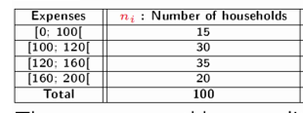
Examples - calculation of the mean
Example 3 :
The data below represents the monthly expenses of 100 households for the purchase of a certain product
Calculate the mean monthly expenses.

Slide 25
Note

Slide 26
Exercise
The data below represents the age of visitors to a website:
Age | Number of visitors
< 18 | 5
[18 ; 20[ | 15
[20 ; 30[ | 20
[30 ; 35[ | 30
[35 ; 50[ | 23
≥ 50 | 7
Find the right proposal (among the four proposals below) :
[30; 35[ is the modal class
55 is the center of the last class
The mode is equal to 19 years
The average age is equal to 32.25 years

Slide 27
Note

